Slide 1



TOX MAS
TRACK : AI & SOCIAL IMPACT
Team_TechVerse

Slide 2


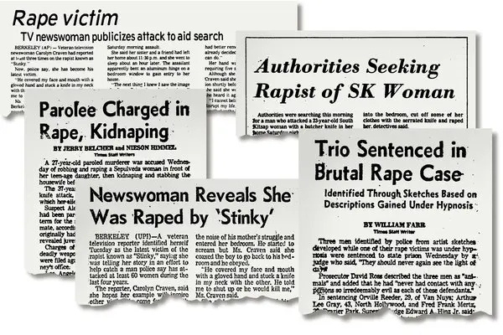
PROBLEM
Early exposure of children to pornographic content.
Threats to women using their private videos.
AI-driven Deepfake technology causing harm.
Addiction to pornographic content.
By Team_TechVerse

Slide 3
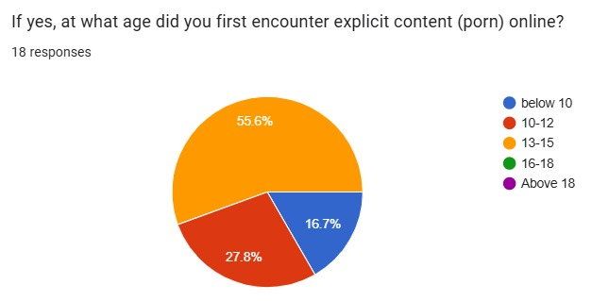
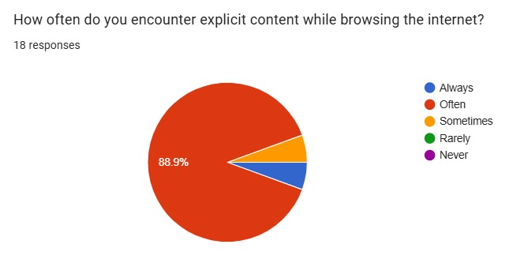

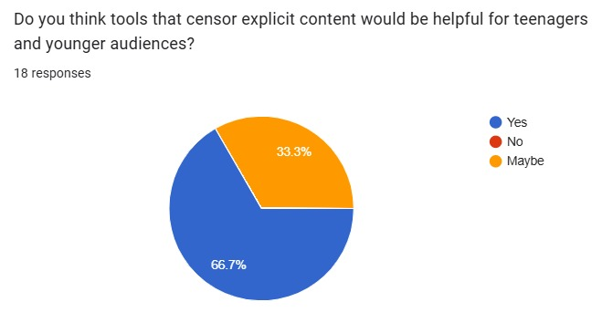
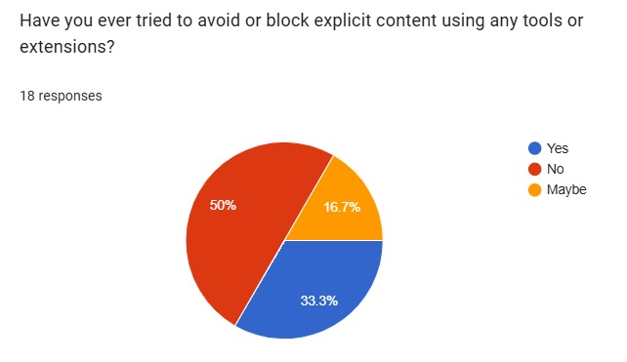
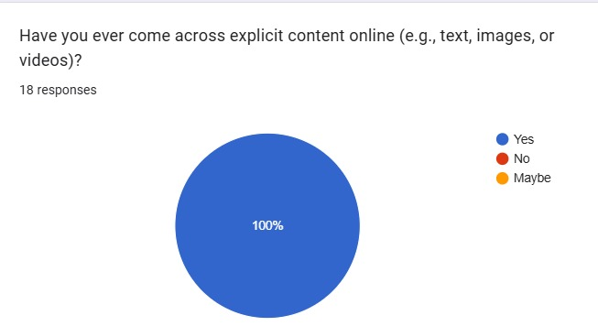
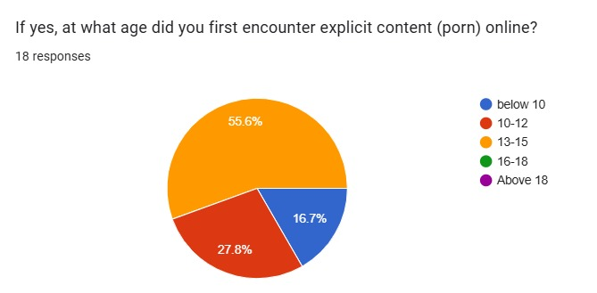
Survey
On Pornography
Team_TechVerse

Slide 4




An extension primarily developed to prevent children from exposure to abusive content on the internet. It is also helpful in assisting porn addicts and benefiting common users.
A framework designed to process various kinds of documents, aiming to analyze and provide censored content to society.
TOX MAS
THE SOLUTION
An AI tool for identifying Deepfake content and generating clothing for nude images, thereby mitigating the toxic spread of such materials.
Team_TechVerse

Slide 5

01
Active Fence:
Primarily designed for large-scale content moderation for businesses and social media platforms, making it less accessible for individual users or families.
EXISTING TECHS
02
Smart Moderation:
Focuses on moderating text-based content on social media platforms, neglecting other forms of explicit media like images, audio, or videos.
03
Google Parental Control System:
Primarily focuses on monitoring screen time, managing app usage, and filtering websites. It lacks tools for censoring explicit text, images, audio, or videos.
Team_TechVerse

Slide 6

TECH
STACK
VISION
Deep Learning Models:
The Roberta model is used for analyzing text in images and documents. The Nudenet model identifies NSFW content in videos and images. The Xception model detects Deepfake content spreading across the internet.
Web Application:
The front end is developed using Tailwind CSS and Alpine.js, ensuring responsiveness. The back end utilizes Flask and MongoDB to handle data processing and storage efficiently.
01
03
Chrome Extension:
Two types of extensions serve three purposes. One extension censors text and images containing nudity. The other provides parental controls for monitoring and safeguarding children’s devices.
Cloud:
DigitalOcean is used as the cloud service provider due to its partnership with MLH, offering easy setup and cost efficiency.
02
04
Team_TechVerse

Slide 7

MARKET SIZE
54%
60+
20+
of teens had seen pornography by the time they were 13 years old
OTT Platforms
Famous text analzying platform
(Browser Extension)
(Video Moderation)
(Profanity Analyzerr)
Target audience: Parents, Porn addictions and Companies like Amazon prime, Hotstart, Quilbot etc..
Team_TechVerse

Slide 8



FUTURE
ROADMAP
Adaptive AI learning
Real time content moderation
Integration with Social media platforms
Multilingual support
Team_TechVerse

Slide 9
THANK YOU
Team_TechVerse

